Slide 1
Module 2: Network Systems
Final assignment Nedap University

Slide 2
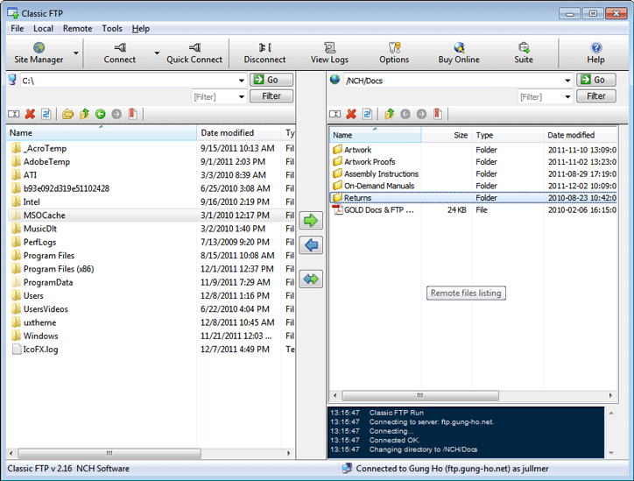
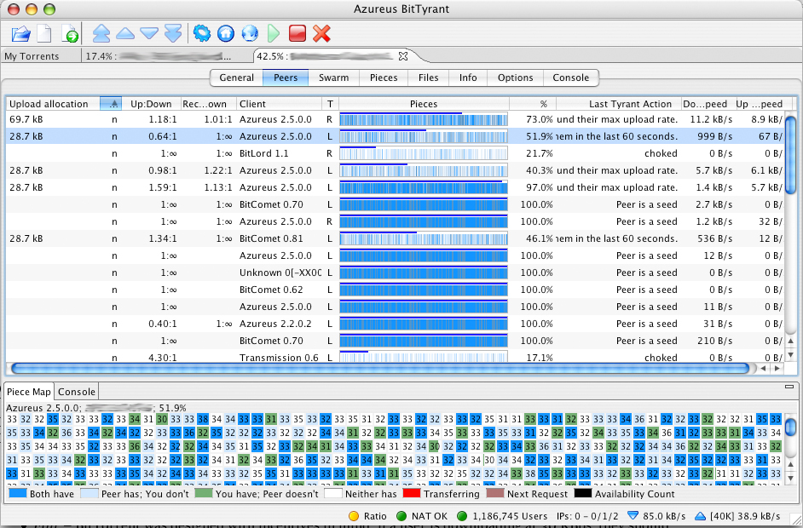
Introduction
Notes:
hendrik

Slide 3

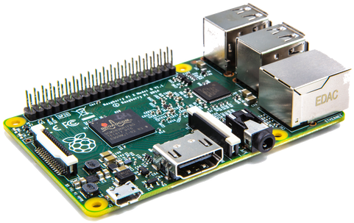




Assignment
Develop a file storage application for a Raspberry PI
Develop a client application for a laptop
Implement reliable upload & download of files
Restrictions
You need to use UDP
TCP is not allowed
Must be able to deal with unreliable networks (packet loss)
Individually
Notes:
thomas

Slide 4
Planning
Kick-off
Wed. 06-04
Work on assignment
2 weeks
Deadline
Wed. 20-04 23:59
Tournament
Thu. 21-04
Presentation & evaluation
Fri. 22-04
Report & code
Drinks & snacks
Notes:
hendrik

Slide 5

Tournament
Functional demonstration of solution
Different rounds
Network will be more unreliable every round
Student with fastest file transfer is the winner
Grand Prize
Notes:
thomas

Slide 6
Report & presentation
Report
High level overview
Explain protocol
Explain parameters
Statistics
Present your work (max 10min)
No demo needed
What are you proud of?
What could be done better?
Notes:
hendrik

Slide 7
Recommendations
Setup your PI today
Contact us (Thomas or Hendrik) when you're having problems with the assignment overall
Contact your coach for specific programming issues
Plan ahead
Have Fun!
Notes:
thomas

